Slide 1
Aciurina

Slide 2
Ericameria

Slide 3
Aciurina

Slide 4
Ericameria

Slide 5
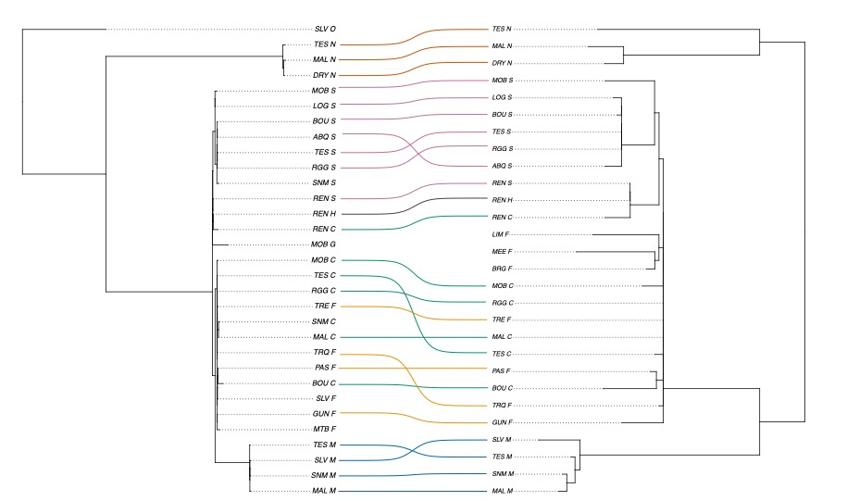
Aciurina
Ericameria

Slide 6
Aciurina K

Slide 7
Aciurina K

Slide 8
Aciurina K

Slide 9
Aciurina K

Slide 10
Ericameria K

Slide 11
Ericameria K

Slide 12
Ericameria K

Slide 13
Ericameria K

